Slide 1
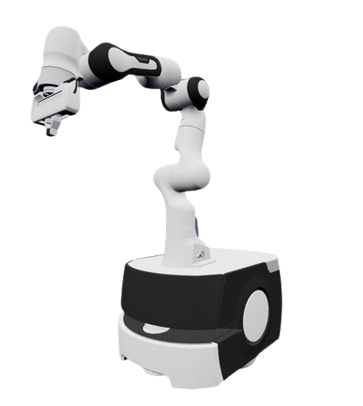

Robot Control –
Mobile Manipulation
M-D5320ZE – Robot Control Applications A.Y. 2025-2026
Fernandez Sergio, Panico Federico, Carnio Alessandro
Robot Manipulation
Pick-and-Place Task

Slide 2






Project Goals
Base
Extensions
•
Goal:
Develop a full autonomous Pick-and-Place pipeline on a mobile manipulator
Obstacle Detection and Avoidance
•
Robot:
Frankie – mobile base + Panda Arm
Integrate environment obstacles like walls
•
Solve the problem of finding shortest path
•
Primary Task
Lightbulb random generation
Safe and efficient navigation to bulb
Dual Robot Collaboration
Introduce a second robot
•
Execute cooperative tasks
•
Transport the bulb to a target location fixed
Grasping and manipulating the bulb
Vision-based Localization
Replace predefined bulb coordinates with real-time detection
•
Screwing the bulb in place using coordinate motion and end-effector
Return in start position and restart simulation
Implement color or shape recognition
•
1

Slide 3
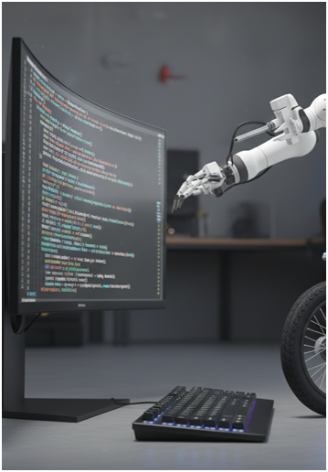
01
Basic Development

Slide 4
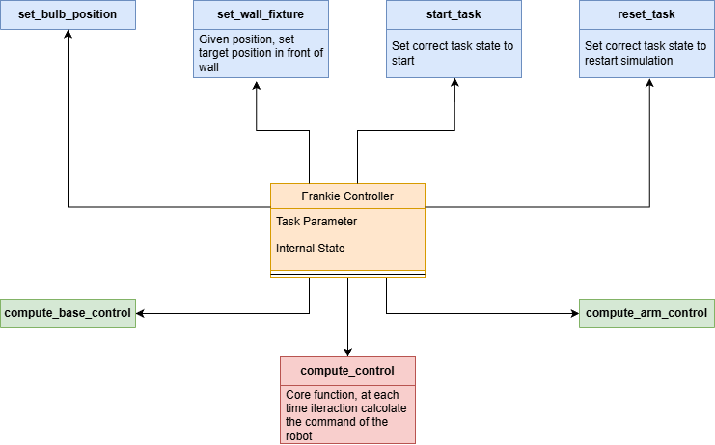
controller.py
Utility functions
Movement Control
Main Robot Control
2

Slide 5









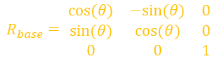

Movement Control
Compute_arm_control
Compute_base_control
Input
Input
target_pos
base_state
target_orientation
base_state
target_xy
$$R_{base}= \begin{matrix}cos⁡(θ) & −sin⁡(θ) & 0 \\ sin⁡(θ) & cos⁡(θ) & 0 \\ 0 & 0 & 1\end{matrix}$$
$$e_{world}=p_{target}−p_{ee}$$
$$∆x=g_{x} , ∆y=g_{Y}−y$$
$$e_{pos}=R_{base}^{T}∗e_{world}$$
$$θ^{∗}=atan2(∆x,∆y)$$
$$p=\sqrt{∆x^{2}+ ∆y^{2}}$$
$$J=robot.jacob0(q)$$
$$J_{inv}=J^{T}{\left(JJ^{T}+ γ^{2}I\right)}^{−1}$$
$$v=K_{v} ∗p$$
$$q_{arm}=K_{p}∗J_{pinv}∗e_{pos}$$
$$ω=K_{w}∗e_{θ}$$
3

Slide 6

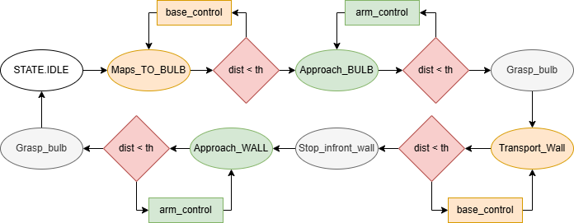
Compute Control
Core function
•
At each time step, give the action to do
•
Check control
Base Movement
Arm Movement
Transition State
4

Slide 7
pick_and_place.py
FrankieAgent Class
Environment Setup
Execution Loop
Wraps the URDF Frankie model and its mobile base
The environment include:
At each time step:
A floor representing the workspace
•
Compute control
•
Initial joint configuration
A wall (cuboid)
•
Update robot joints
•
A screw fixture (cylinder)
Move lightbulb when grasped
•
•
Unicycle-style base dynamics
•
A lightbulb + tower spawned at random
•
Save log metric
Apply joint/base velocity commands
Check task completion
•
5

Slide 8
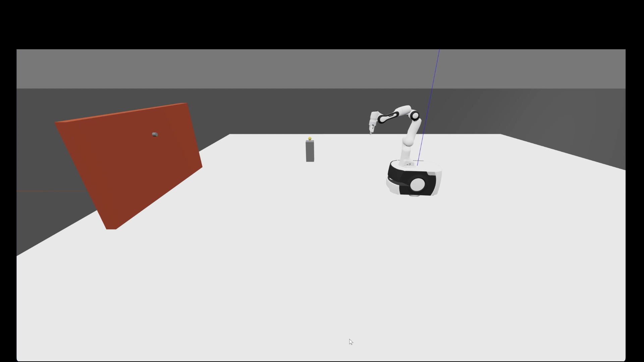
Simulation
6

Slide 9
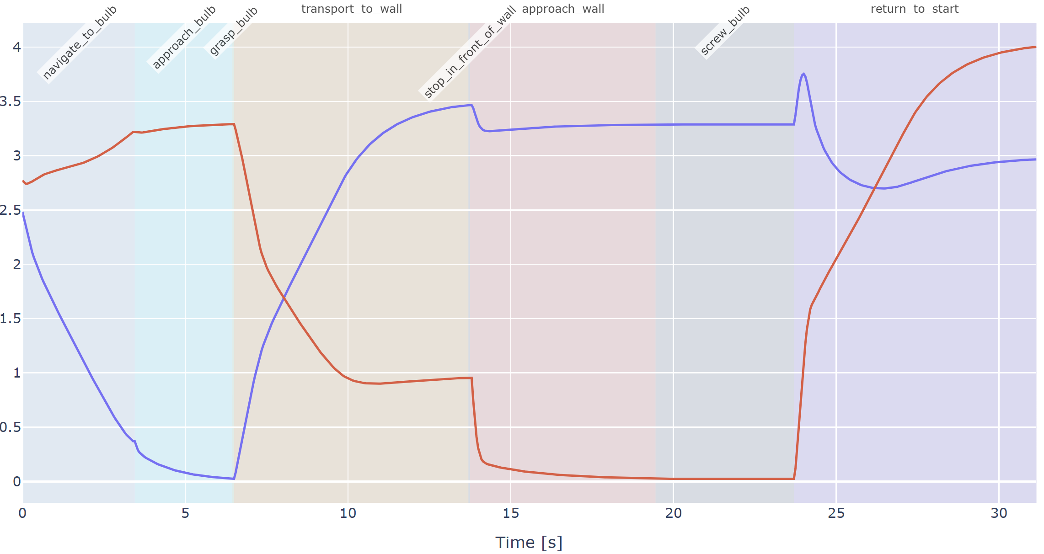
Visualizations
EE – Fixture [m]
EE – Bulb [m]
7

Slide 10
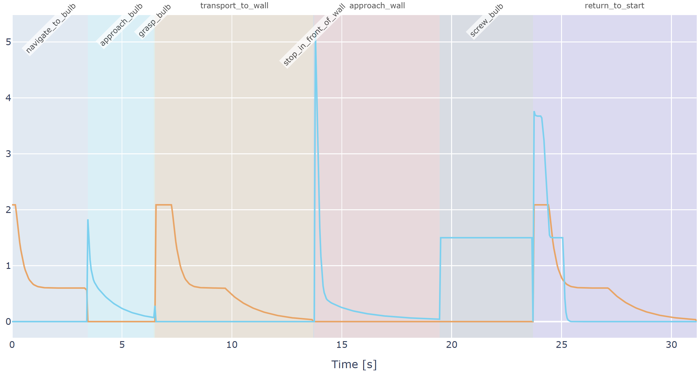
Visualizations
Arm velocity [m/s]
Base velocity
[rad/s]
8

Slide 11
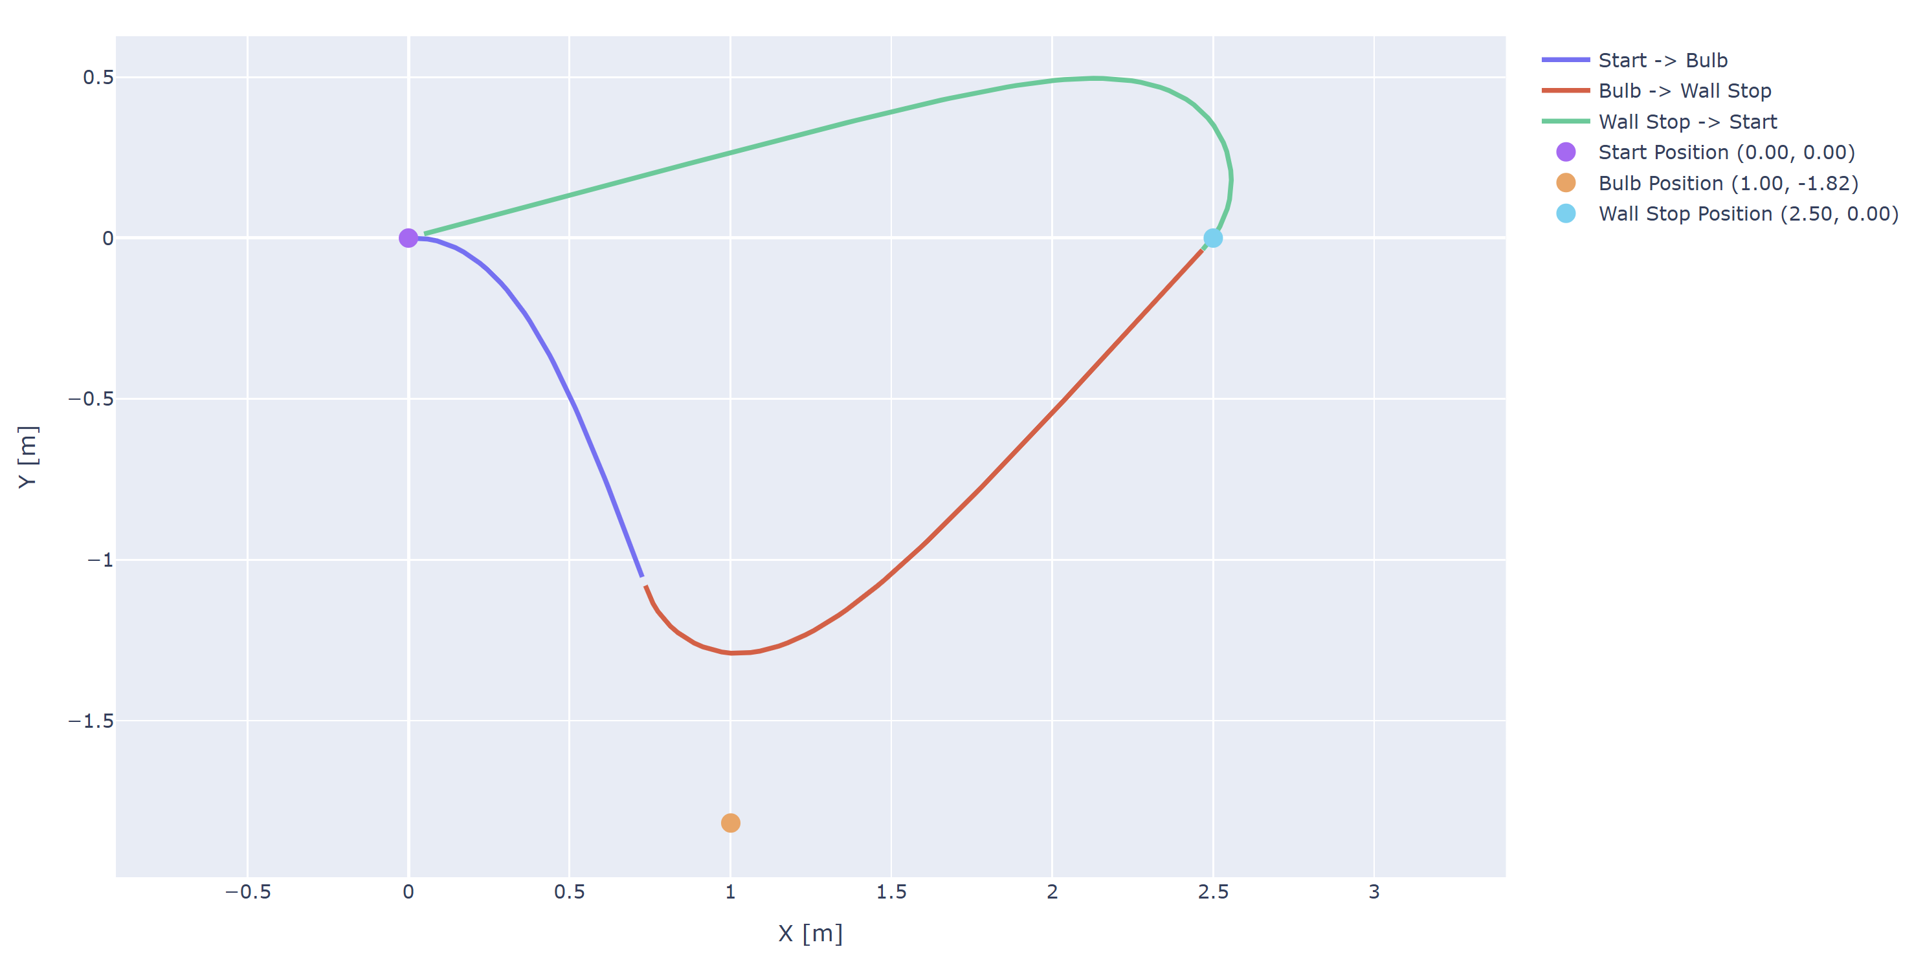
Visualizations
9

Slide 12
02
Extended Version

Slide 13
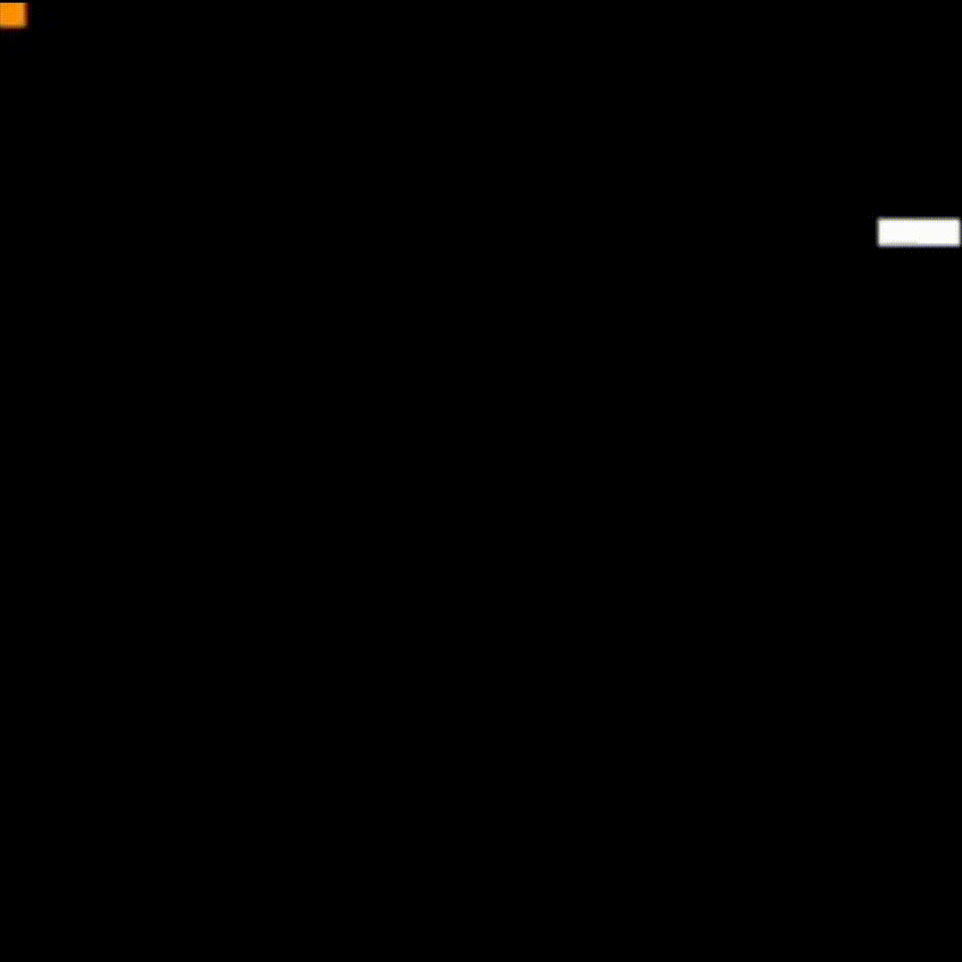
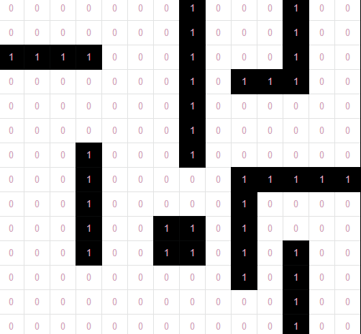
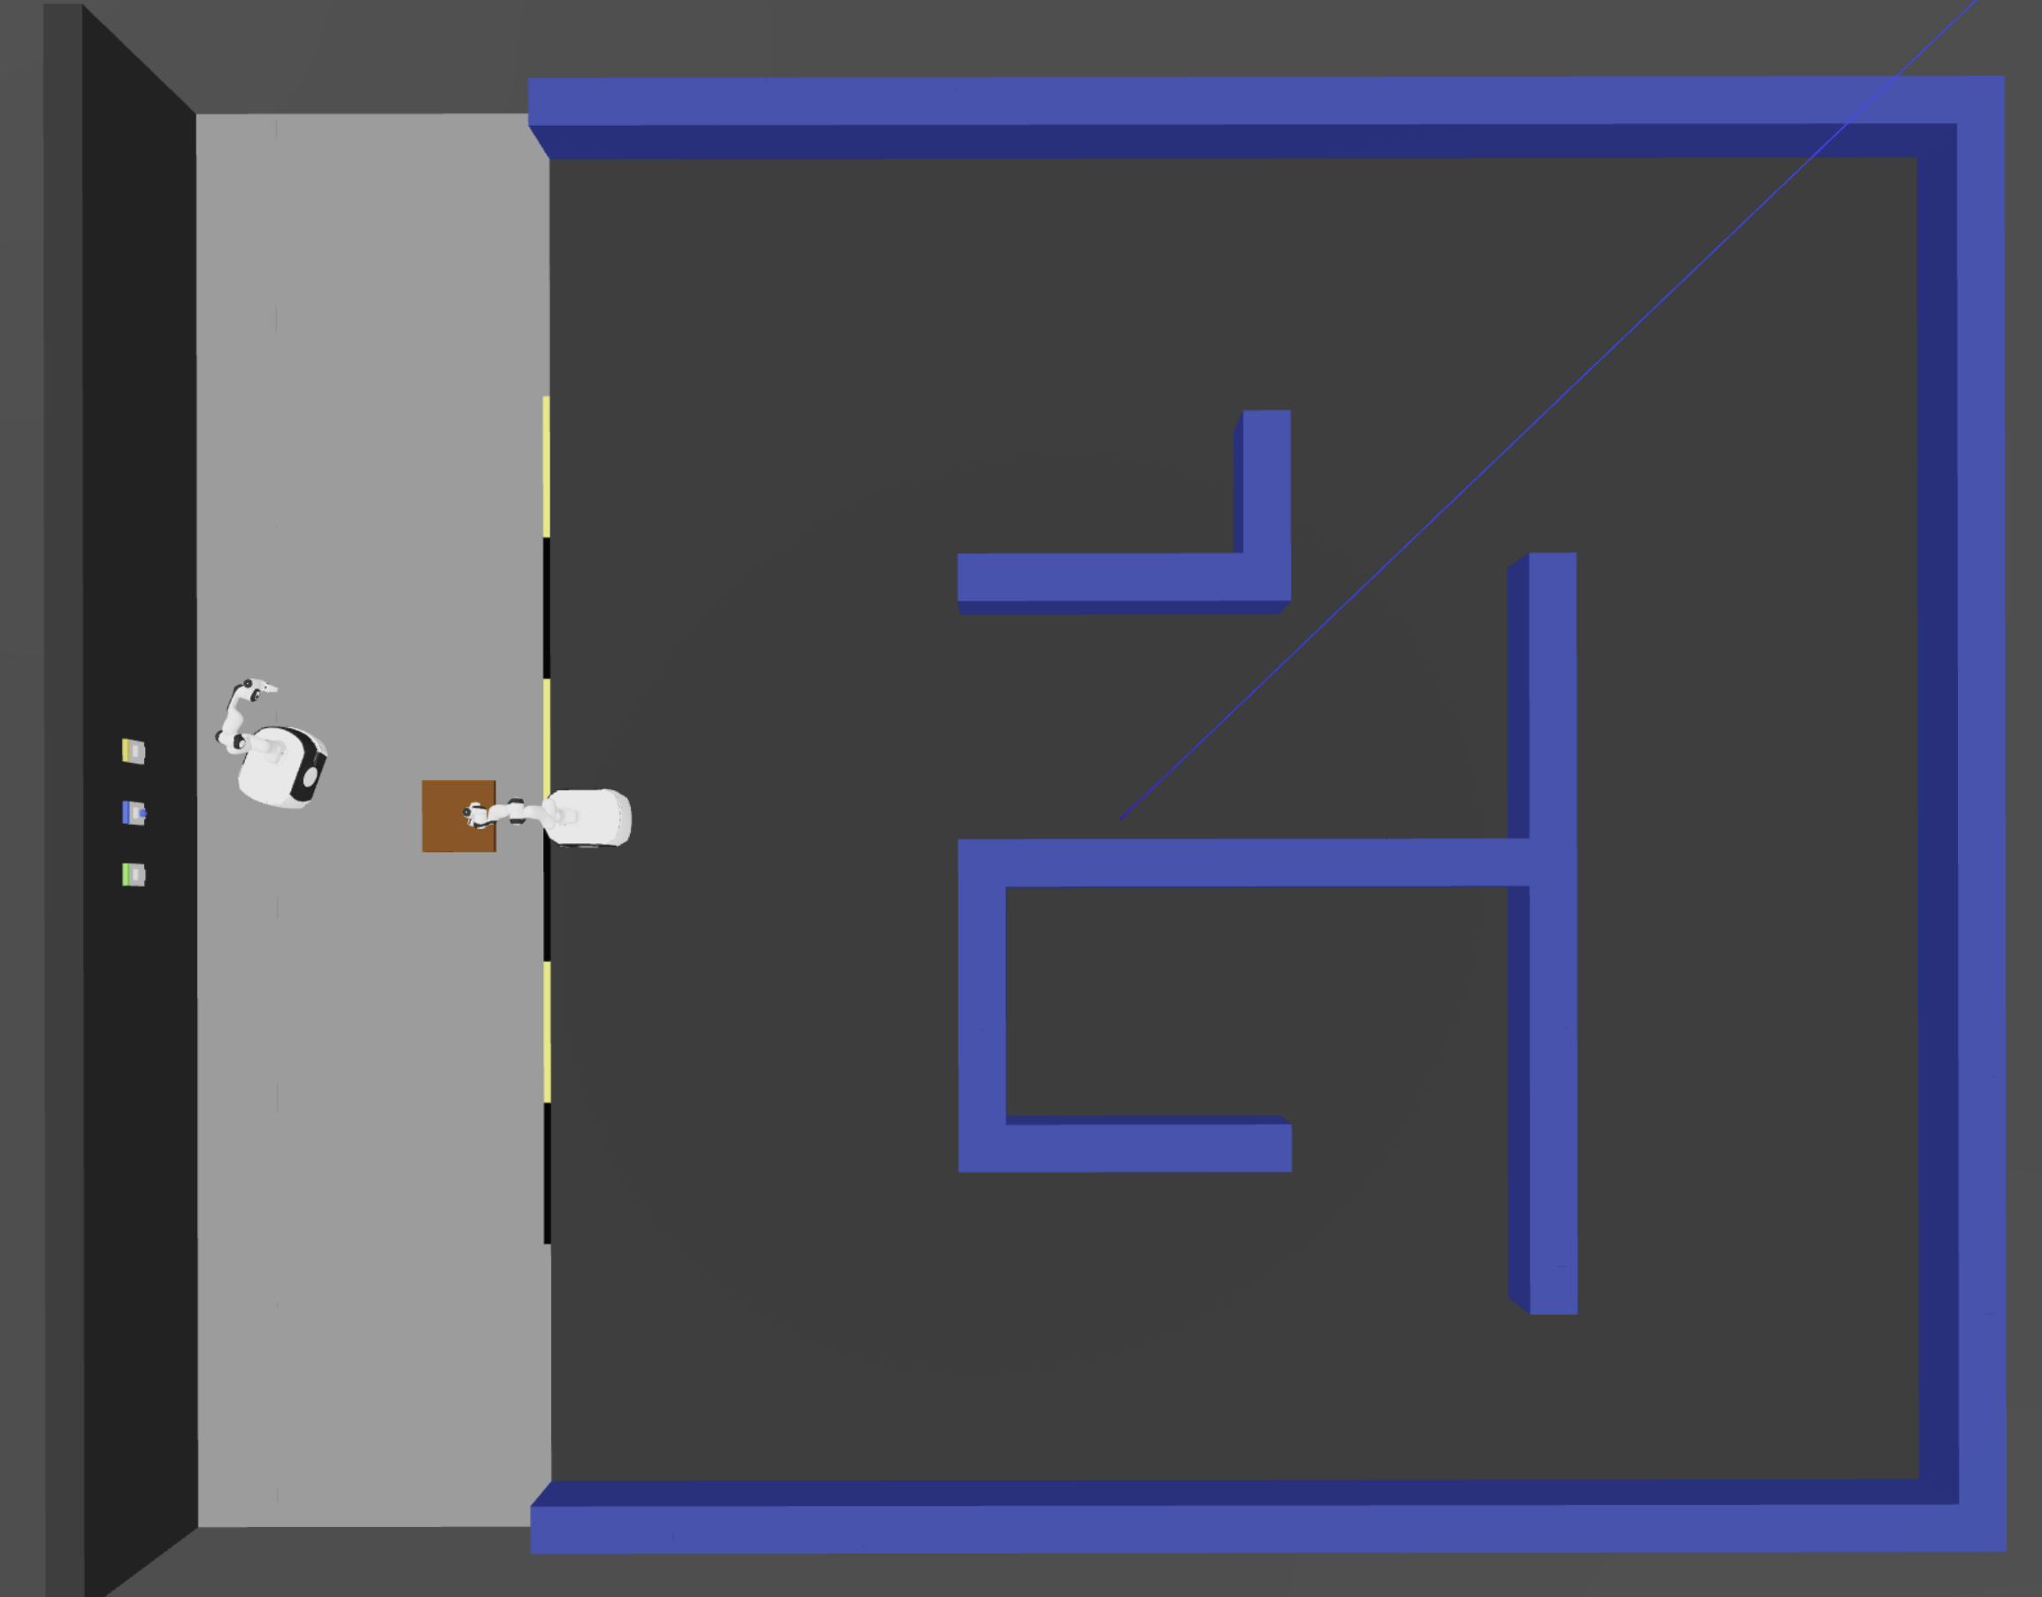
Maze and environment generation
Random Depth-First Search generator
place_walls_from_grid
add_flor
Removed external walls
Build Maze scene
_scale_maze_thin_walls
10

Slide 14
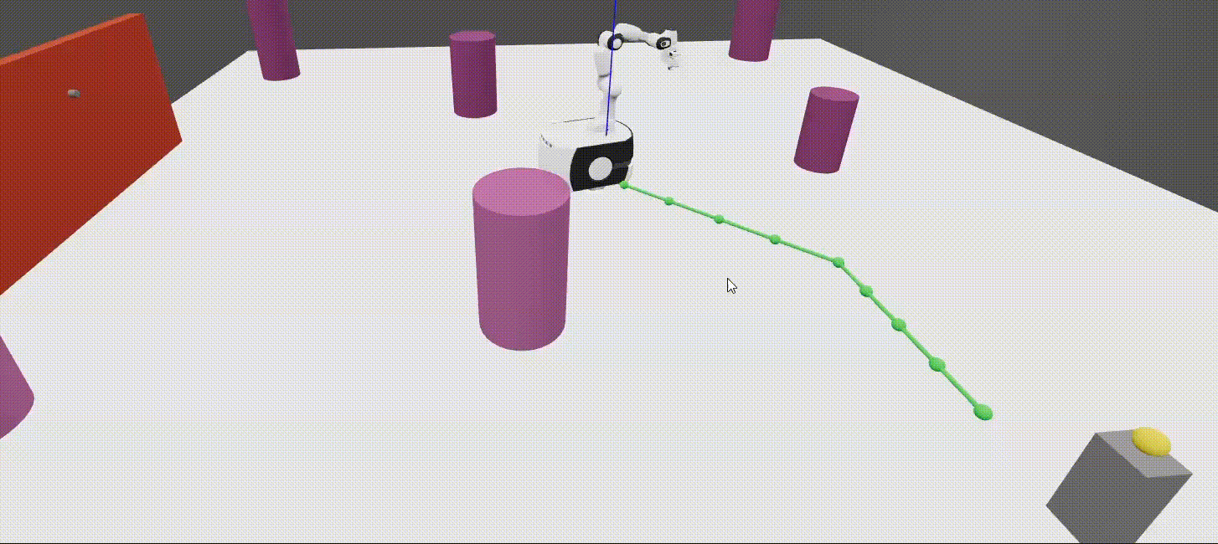
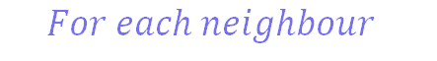
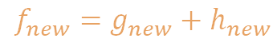

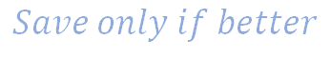




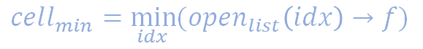
A* star search algorithm
$$open_{list}=[start,…]$$
$$close_{list}=[…]$$
$$Until open_{list} empty$$
$$cell_{min}=\min_{idx}{(open_{list}\left(idx\right)→f)}$$
$$For each neighbour$$
$open_{list}=[start, cell_{new}$]
$$f_{new}=g_{new}+h_{new}$$
$$close_{list}=[{cell}_{min}]$$
$$Save only if better$$
11

Slide 15
Collaborative Task
MazeGrasper
BulbScrewer
Start
Start
Navigate in maze
Navigate to Bulb
Approach Bulb
Approach Bulb
Buffer
FIFO
Navigate in maze
Transport to Wall
Approach_wall
Approach_wall
Repeat
Repeat
12

Slide 16
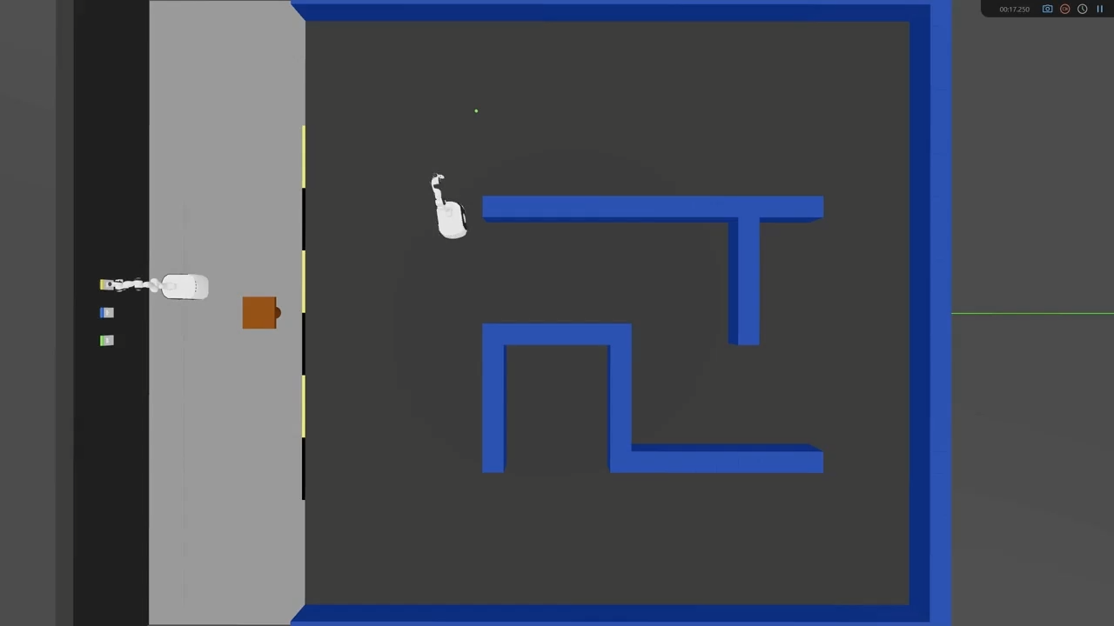
Simulation
13

Slide 17
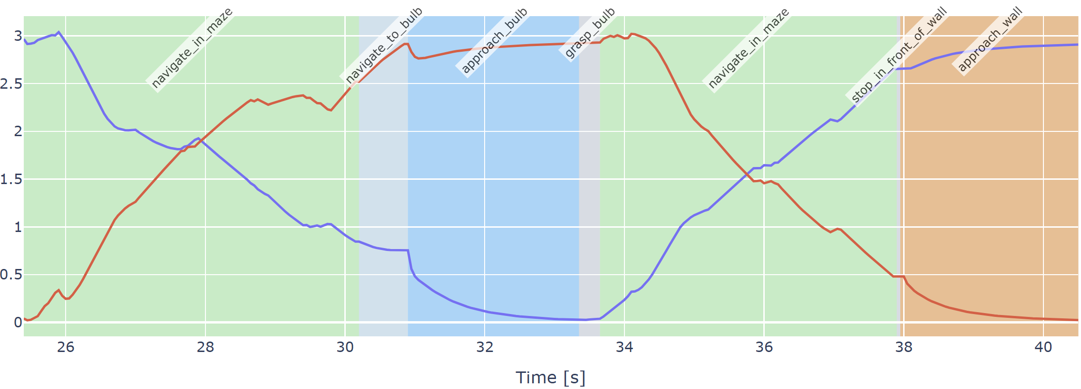
Visualizations
EE – Fixture [m]
EE – Bulb [m]
14

Slide 18
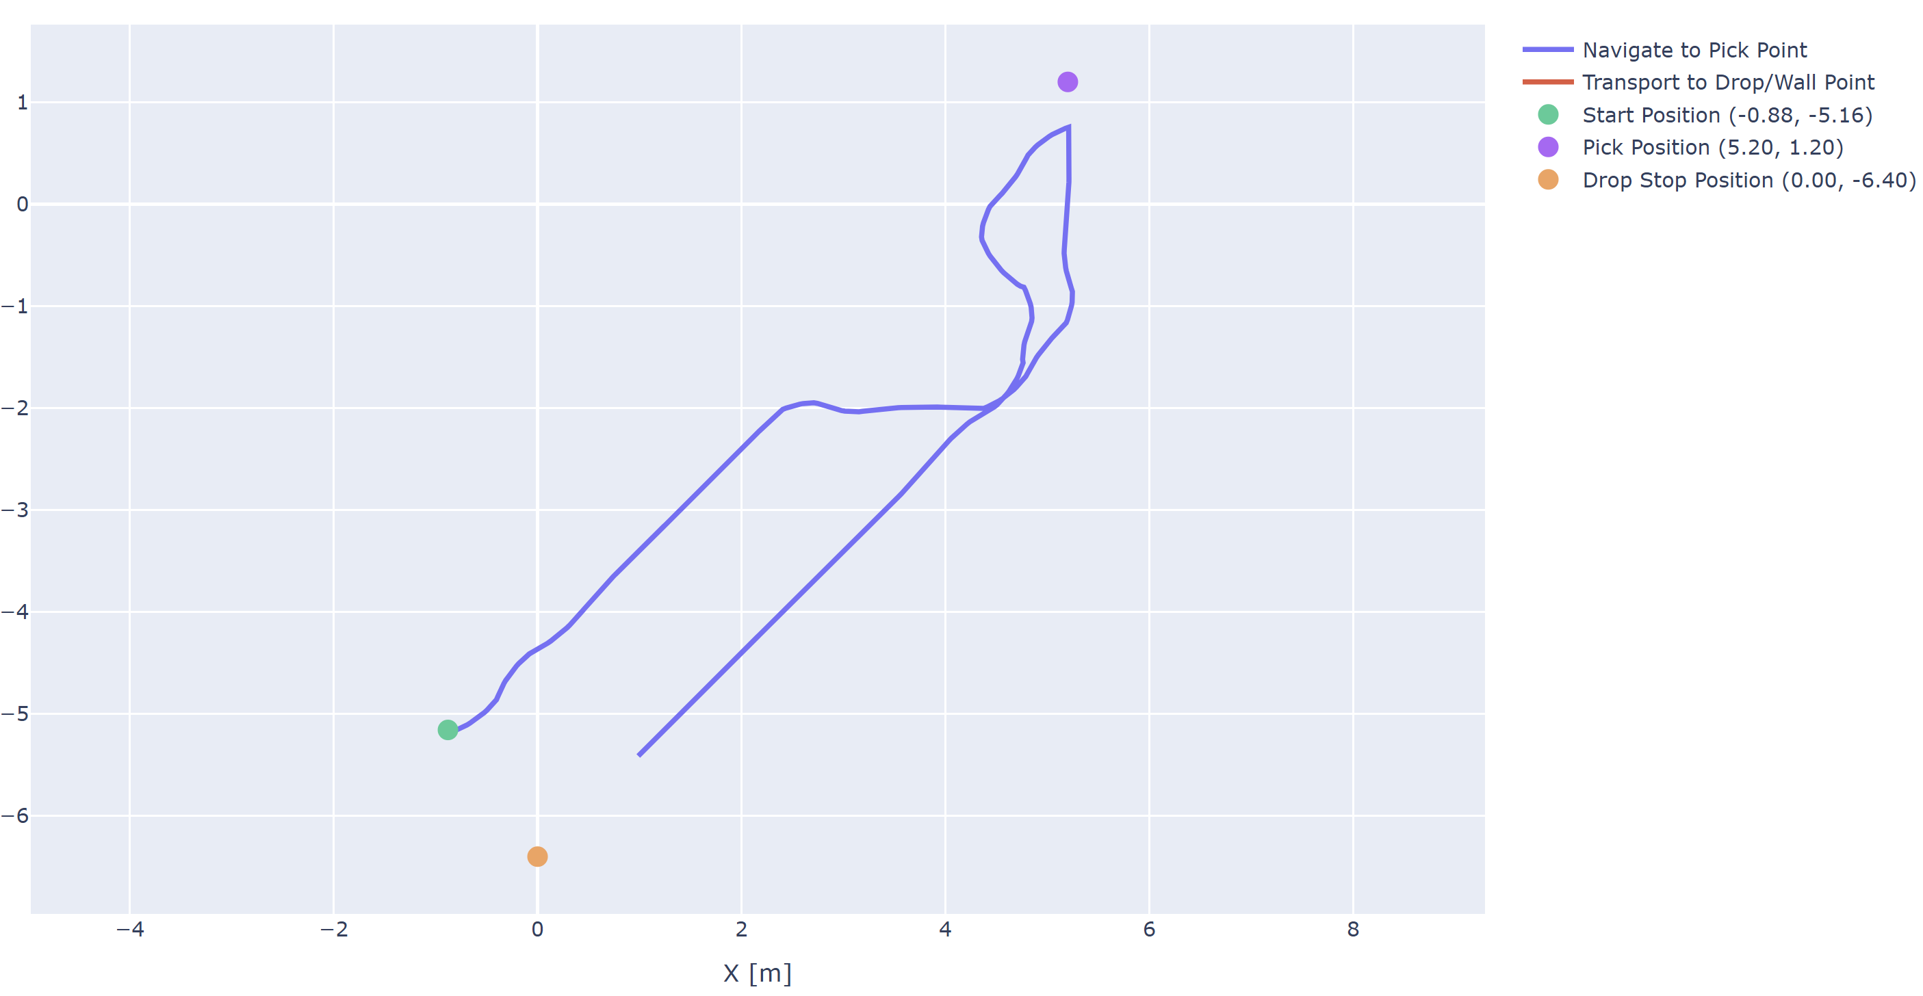
Visualizations
15

Slide 19
THANK YOU
Questions ?

